Slide 1
RIP
By
Attia Agha

Slide 2
RIP
Routing Information Protocol (RIP) is a dynamic routing protocol that uses hop count as a routing metric to find the best path between the source and the destination network.
It is a distance-vector routing protocol. ( Distance vector routing is a routing protocol that uses the shortest path to a destination as its primary criterion. This algorithm is used in local-area networks, metropolitan-area networks, and wide-area networks)

Slide 3
Cont.
RIP works on the Network layer of the OSI model. RIP uses port number 520.
Hop count is the number of routers occurring in between the source and destination network.
The path with the lowest hop count is considered as the best route to reach a network and therefore placed in the routing table. RIP prevents routing loops by limiting the number of hops allowed in a path from source and destination.
The maximum hop count allowed for RIP is 15 and a hop count of 16 is considered as network unreachable.

Slide 4
Feature of RIP
1. Updates of the network are exchanged periodically. 2. Updates (routing information) are always broadcast. 3. Full routing tables are sent in updates. 4. Routers always trust routing information received from neighbor routers.

Slide 5
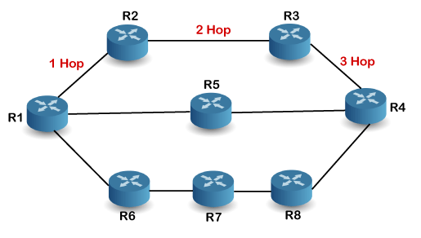
How is hop count determined?
In the above figure, when the router 1 forwards the packet to the router 2 then it will count as 1 hop count. Similarly, when the router 2 forwards the packet to the router 3 then it will count as 2 hop count, and when the router 3 forwards the packet to router 4, it will count as 3 hop count. In the same way, RIP can support maximum upto 15 hops, which means that the 16 routers can be configured in a RIP

Slide 6
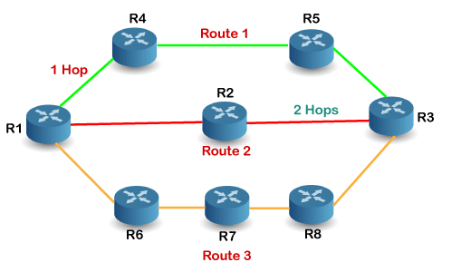
How RIP works
If there are 8 routers in a network where Router 1 wants to send the data to Router 3. If the network is configured with RIP, it will choose the route which has the least number of hops. There are three routes in the above network, i.e., Route 1, Route 2, and Route 3. The Route 2 contains the least number of hops, i.e., 2 where Route 1 contains 3 hops, and Route 3 contains 4 hops, so RIP will choose Route 2

Slide 7
Advantages
The following are the advantages of a RIP protocol:
It is easy to configure
It has less complexity
The CPU utilization is less

Slide 8
Dis advantages
Inability to support paths longer than 15 hops.
Reliance on fixed metrics to calculate routes.
Network intensity of table updates.
Relatively slow convergence.
Lack of support for dynamic load balancing

Slide 9
RIP Message Format
Command: It is an 8-bit field that is used for request or reply. The value of the request is 1, and the value of the reply is 2.
Version: Here, version means that which version of the protocol we are using. Suppose we are using the protocol of version1, then we put the 1 in this field.
Reserved: This is a reserved field, so it is filled with zeroes.
Family: It is a 16-bit field. As we are using the TCP/IP family, so we put 2 value in this field.
Network Address: It is defined as 14 bytes field. If we use the IPv4 version, then we use 4 bytes, and the other 10 bytes are all zeroes.
Distance: The distance field specifies the hop count, i.e., the number of hops used to reach the destination

Slide 10
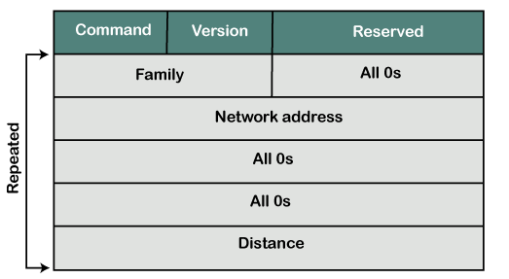
Cont.

Slide 11
RIP versions
There are three versions of the Routing Information Protocol:
RIPv1.
RIPv2.
RIPng.
RIPv1 -- standardized in 1988 -- is also called Classful Routing Protocol because it does not send subnet mask information in its routing updates. On the other hand, RIPv2 -- standardized in 1998 -- is called Classless Routing Protocol because it does send subnet mask information in its routing updates. RIPng is an extension of RIPv2 that was made to support IPv6

Slide 12
Versions cont.
In RIPv1, routes are decided based on the IP destination and hop count.
RIPv2 advanced this method and started to include subnet masks and gateways.
Furthermore, the routing table in RIPv1 is broadcast to every station on the attached network whereas RIPv2 sends the routing table to a Multicast address in an effort to reduce network traffic.
Additionally, RIPv2 uses authentication for security -- a feature missing from RIPv1

